Slide 1
Dell SecureWorks
Our story on how we can get to market faster
Notes:
Hello and welcome. Thank you for attending my presentation on Dell SecureWorks and our story on what we’ve done to get to market faster. My name is Leandro Bonvehi. I’m a senior engineering at Dell SecureWorks and have been with the company for the last 8 years.
At SecureWorks I’m leading the DevOps implementation to transform how the engineering organization delivers and deploys software. Today I take you through our journey. I’ll go over our business objective, we’ll look at the internal engineering challenges, and the steps that we’ve taken in order to increase our efficiencies. We’ll have a quick look at our solution and have a little Q&A at the end.

Slide 2

Dell SecureWorks at a glance
Edinburgh, Scotland
Quincy, WA
London
Bucharest, Romania
Chicago, IL
Providence, RI
Kawasaki, Japan
Myrtle Beach, SC
Atlanta, GA
Round Rock, TX
SOC and Data Center
SOC
Additional Staff
Data Center
Hyderabad, India
Sydney
70+ Countries
3.8K+ Customers
1K+ Security Pros
200+ Engineers
158K+
Devices
~85B
Daily Cyber Events
3K+
Daily Escalations
24 x 7 x 365
10/22/2014
2
Confidential
Notes:
Dell SecureWorks is a international company with close to 4 thousand customers in over 70 countries. We have over 158 thousand managed or monitored devices that see 85 billion cyber events every day. The company employs over 1 thousand security professionals and over 200 engineers.
In a nutshell, what dell SecureWorks does is deliver to our customers what they need to know and what they need to do from a security perspective so that they can focus on running their business.

Slide 3
Business Objective
Notes:
Now that you know a little more about the company let’s look at Engineering’s business objective

Slide 4


Business Objective
Quality
Maintain high
quality standard
Maintain high platform availability
Availability
Lifecycle
Get to Market Quicker
Move to value based release schedule
Respond
Reduce time to market
Notes:
Our business objectives are very basic and revolve around a main goal which is to get to market quicker.
We want to continue to do this while also maintaining a high standard of quality. We don’t want to trade quality for speed.
In order to protect our customers and respond to the billions of cyber events we need to be provide a high level of platform availability by being fully operational 24 X 7 X 365 day of the year. At a rate of 59 million events per minute any down time can be costly.
We want to respond quickly to our customer needs by reducing our time to market so that we can provide new products, features, and new ways to combat cyber threats.
For many years we’ve delivered software on a quarterly basis. With the rapid shifts in the market we believe that we can provide a better experience for our customers by moving from quarterly releases to value based releases on a monthly schedule

Slide 5
Our Challenges
Notes:
In the following section I will cover our internally challenges which come in many forms such as software, datacenters, and system configuration. Although these are the challenges we face I‘m sure that many of you will relate to many of them.

Slide 6
Technology Challenges
Confronting today’s security challenges requires extremely sophisticated and complex systems. This complexity presents a unique set of challenges
Server Count
2100+ servers
Software Library
350+ Software Packages (rpms), many are installed across different servers types
Continuous software builds
Configuration Management
No unified configuration management strategy
Harmonious system which can be crippled by a misconfiguration
80+ different server-types
Notes:
Confronting today’s cyber security challenges requires extremely sophisticated and complex systems which themselves present a unique set of challenges.
In total we have over 2100 servers across all of our test and productions environments. That number does not include appliances or any corporate servers. This number strictly refers to systems used to provide our services to our customers. These servers break down into more than 80 different server types, or servers that server a different function. To further complicate things the number of servers serving the same roles, servers within a server-type, differ from environment to environment.
We have an extensive software library comprising of over 350 software packages. They range in size from just a few kilobytes to a couple hundred megabytes. Some of the software packages share the same libraries, many are installed across many different server types, and many conflict with one another.
All of our systems are in one way or another interconnected. It’s one harmonious system. In order to achieve this harmony all systems must be properly configured to communicate with one another. A misconfigured server can be very problematic. A very big problem of ours was that up until recently we did not have unified configuration management solution that spanned across all of our environments. Engineering did things their way in test environments and then documented those changes. Our Application Deployment team would follow the documentation and apply those changes to the production environments. As you can imagine this effort was time consuming and error prone.

Slide 7
Technology Challenges - Continued
Datacenters Locations
Datacenters in different geographies, active/active model
Production & lab datacenter not 100% aligned
Network Segmentation
Network segmentation driven by security requirements
Segmentation between production and lab silos
Segmentation between networks within silos
Siloed System Responsibilities
Bare metal server builds & server management not performed by the same team
Software deployment & configuration responsibility falls on different teams depending on environment
Notes:
When it come to datacenter locations we have multiple sites within the United States in an active active model. Not only do our sites operate in an active active model but so does our software. Our test environments sites are not 100% aligned. Some of our testing sites do not exit in our production environment and vise versa. We also have a far superior number of servers in our production sites. Our test ‘are miniature production environments.
We have a complex network layout that we segment due to security reasons. We obviously separate our production and test environments but not only due to security reasons but also to minimize cross environment contamination. Aside from environment segmentation we also have separation of networks within environments.
Due to the nature of our business we have strict policies on which personnel can take actions on particular environments. These policies results siloed responsibilities. Things such as bare metal builds or server management are performed by different teams for different environments. If you haven’t gotten it from my previous slides the same goes for software deployment and application configuration.

Slide 8
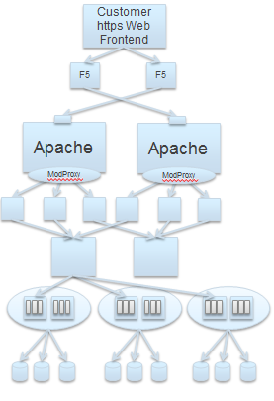
Platform System Details
Deployment done from the bottom up
Active-Passive
Bastion Hosts
Java Servlet
Non-standard containers
Load Balancer
HA
Core Services
Active-Active
Databases
Oracle & MySQL
Notes:
What you see here is an example of an individual stack of part of our platform. At the top we have the customer web front end. Network traffic comes in and traverses a first set of load balancers and reaches our bastion servers. The bastion host then make request or forward their traffic to our core services. The bastions servers don’t know of the core servers themselves but they know of the load balancers in front of them. This is the second set of load balancers that the traffic traverses. Based on the health of the service requested by the bastions and number of connections, the load balancers makes a determination as to which server it should forward the traffic to. The traffic is forwarded to a core server where it either does work or makes further queries to our databases. Each core server has multiple services which are the items that you see inside of the core services bubbles.
Our software deployments are performed from the bottom up. Deployments of the same server type are performed serially, while deployments of different server types are performed in parallel.

Slide 9
Our Approach
Notes:
Now that you have a better idea of our challenges I’ll talk about the approach taken to deal with them so that we can meet or business objectives.

Slide 10
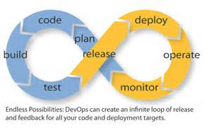
Layer between development and operations
DevOps
Management acknowledge the gap in our organization and used this opportunity to introduce a new team to act as a bridge between Engineering and Operations.
The team’s responsibility would be to identify ways to improve our efficiency with a focus on release automation.
Existing staff members with already in depth knowledge of the company and application were chosen to drive the effort.
Notes:
First and foremost management acknowledge a gap in our organization. We had already been through team restructuring, head count increase, shift in responsibilities and great emphasis on test automation. All of these steps made significant improvements but something new was needed to directly deal with improving our efficiencies.
Management decided to form a new team, to server as layer between engineering and operations. The team’s responsibility to focus on release automation. Rather than hiring from the outside the decision was made to tap existing staff members who already a had an understanding of the company.

Slide 11
Phase 1 - Immediate Relief to Engineering
Test Environment Deployments
Simple solution to deploy or update servers based on their server type
Aligned daily update time
Alignment of Environments
Decommissioned unused servers
Rebuilt where needed
Increased server count where lacking
Test Environment Platform Availability
Reduce down time due to non software related issues
Notes:
The first thing the team did was look for ways in which they could give time back to Engineering. What could we do to allow engineers to spend more time developing and testing. We found that 2.5 hours per day were spent updating our test environment. During that time the environment was usable but unstable. The update responsibilities fell on different groups within Engineering so the timing of the updates weren’t ideal for everyone.
What we did was provide a home grown automated solution to sync up daily software updates and reduced that time to 7 minutes. 7 minutes though of complete instability. This worked great for engineering wasn’t something that could be used in production because we cannot take any down time there. The solution did not take application configuration or up time into consideration. It simply updated software as quickly as possible.
The next 2 items go hand in hand. Over the years we had been through significant changes in terms of technology and topology but out environment had not always kept up pace. We went through a cleans and rebuild period to align the lab with the production environment. We removed anything that wasn’t need and rebuilt anything needed to match production standards. The decommissioning of virtual machines alones gave us an annual saving of $42K dollars.
As expected this resulted in greater test platform availability as environmental issues for non software related reasons are very low. Our test results were more accurate because the were executed against an environment that more closely resembled production. It also made it easier for engineers to troubleshot issues.
The alignment of the environments if what allowed us to move on to phase 2.

Slide 12
Phase 2 - Application Release Automation
Release Cadence
Move to value based release schedules
Knowledge Transfer Efficiency
Actionable automated process
Reduce release prep work
Eliminate multiple deployment plans tracked by different teams
Unified Deployment and Configuration Model
Repeatable deployment process
Orchestration that takes into account server status and roles
Executable by anyone authorized
Prioritize customer facing components
Notes:
DevOps next major goal was application release automation to support our value based monthly release.
In order to move at such a rapid pace compared to before it was imperative to have a unified deployment and configuration solution along with improving knowledge transfer efficiency.
The deployment and configuration solution needs to be a repeatable across all of our environment. It needs to support orchestration that takes server states into consideration. It also needs to be executable by authorized personnel only. Operations needs to be able to use it against production systems whereas engineering needs to be limited to test environments.
On the knowledge transfer efficiency front our goal was to replace documentation with actionable automated process. This would smooth the handoff process and reduce the prep work ahead of a deployment. It would remove the double effort from Engineering and Operations to create and maintain deployment plans that made sense to them.

Slide 13
A More In Depth Look
Notes:
Now that I’ve layout a picture of our challenges and actions taken to address the issues lets take a more in depth look at our solutions

Slide 14
Unified Deployment and Configuration Model
Deployment Process
Condition Capable
Fully or partially automated transitions
Behavior is environment indifferent
Performs new validations
Follow & track deploy process
Success or failure notification
Has audit trail
Pre- deployment dry-run
Notes:
http://devops.com/features/approaches-to-application-release-automation/
Before deciding on a tool we sat down and defined the things that were important to us. We needed a tool that could make conditional decisions and allowed partial or fully automated deployments. We wanted the tool to perform validation and pre-deployment dry runs. Along with that we wanted notifications and audit trails.
There are many great DevOps tools out there which take different approaches to solve similar problems. They all have their strengths and weaknesses and we needed to pick an approach that worked for us. A couple of example of these approaches are declarative, imperative, and process based.
In the declarative based approach the desired state of the server is defined down to every individual configuration items and assumes that servers can be configured independently. I compare this to making lemonade. The order in which the ingredients are mixed doesn’t matter. In the end lemonade will be lemonade.
In the imperative model a programing language is used to describe what needs to be done on target sever in a series of steps. I compare this cooking a single dish. A particular recipe must be followed in a specific order to get the desired outcome.
In a process based approach the user defines, visually, the deployment process. The tool acts as an orchestrator and synchronizer of changes. It is able to make decisions based on conditions. I compare this to preparing a four course meal. The cooking of the different dishes must be coordinated so that items come out of the kitchen at the right time.
Based on our requirements we knew that we need process based tool and decided on ElectricCommander by ElectricCloud. ElectricCloud is a sponsor of the conference but for those not familiar with Commander it is Continuous Delivery solution to automate and accelerate end-to-end software builds, tests, and deployment processes.

Slide 15
Knowledge Transfer Efficiency
Release Deployment Plan
Existing Approach (weeks)
Which version to deploy?
To what servers?
Sequence?
New Approach (days)
Reuse plan
Unified deploy
What software to deploy?
Required config changes?
New
plan every release
Notes:
With every software release our Application Deployment team must create a deployment plan. This plan is pieced together from all of the documentation provide by Engineering. We use Jira deployment tasks. As you can imagine it’s not easy for the AD team to “translate” all of the task provided by Engineering into a meaningful deployment guide. The team had to figure out the required application configurations changes, what software and version to deploy, to which servers, and in what sequence. This effort alone took roughly 3 weeks.
With the new approach we’re now looking at days. The process is still evolving but we’re targeting for a re-usable plan that rarely changes. We want to deploy the latest software to all servers and always in the same sequence. Rather than creating new plans, we simply want the team to look at the deltas.

Slide 16
Knowledge Transfer Efficiency – Configuration Changes
Dev makes configuration change manually
Dev summarizes work done in form of Jira tasks
QE validates changes and task
Application Deploy (AD) reviews task for validity
AD adds to deploy plan based info from tasks
Configuration templates delivered within software
Execution of procedures automatically add to deploy plan
ENG maintains catalogue of name value pairs
Addition to catalogue only possible by running Commander procedures
Notes:
Where we made the most improvement in the knowledge transfer efficiencies is in the area of application configurations. If you recall from the previous slides there was a manual work, documentation, and validation. An Engineer would make a configuration change and later summarize the work. Another engineer would then validate the task. Post release signoff the AppDeploy team would review the task and add it to their deploy plan. If a task did not contain enough information it would be sent back to Engineering for further feedback.
With the new approach we put a lot of emphasis on moving a much as possible into the software package for Engineering to maintain. We asked of Engineering to take more responsibility in the application configuration by requiring that they ship their software with a template to configure that specific version of the software. The only thing now maintained outside of the software are property values that when combined with the templates produce the applications configuration files.
We use ElectricCommander to turn manual process into actionable automated process. Rather than documenting configuration changes engineers now make changes to the software templates and then execute already predefined procedure in Commander to set the property values. The outcome is a configuration plan that can be updated and reworked until it’s ready for deployment.

Slide 17
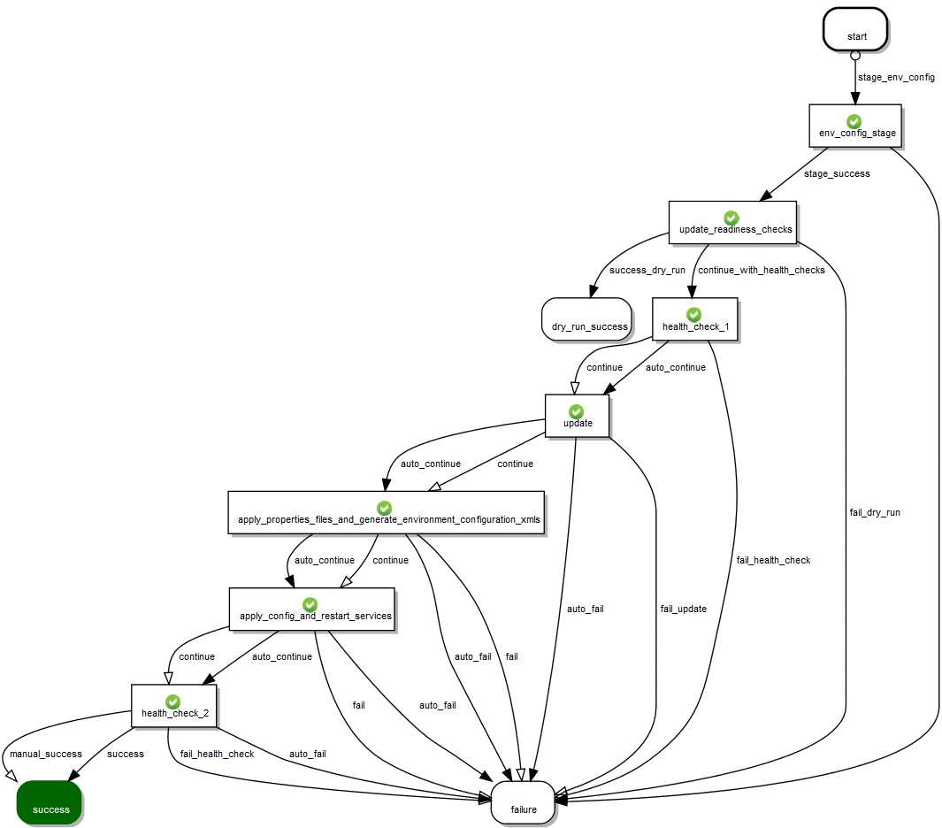
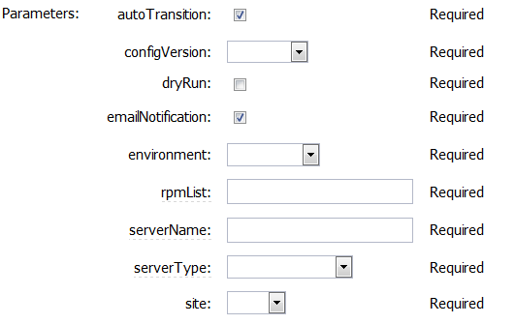
Notes:
What you see here is our deployment and configuration workflow which presently is used against all our supported server types. Each square is a state which represents an action being applied. In our deployments we first stage properties files. This is where name values pairs are extracted from the Commander database, keys stores are sourced from different locations, and at the end are delivered to the target server. The next state are update readiness checks. This where validation is performed to ensure that software is ready for download and that the server is capable of downloading it. We then perform a service health check. It’s important to know the initial state of the service in case that there’s a problem post update. Knowing that there’s a problem ahead of the deployment can help narrow down issues.
We follow that with a software install and update. Now that we have a new template delivered by the new package we produce environment configuration with the properties delivered in the first state. This work is done in a staging directory. If successful at generating the configuration files the next state is to apply them by backing up the old, moving the new ones in place, and then restarting the application. We follow that again by running a health check. If everything look good the workflow continues to a successful state and Commander sends an email notification with a summary of the work done. Equally if it were to fail during any portion of the deployment, the failure state also sends an email notification.
This is an individual workflow to deploy software to a single server. You can see the parameter list needed to deploy the software. What we have done is wrap this in another procedure that coordinates the deployments for all of our server types. Running that procedure is much simpler than this one as it doesn’t require this much information. The only parameters that a user needs to pick are which environment they are working in and the server type which they want to deploy the software to. With data stored in Commander, it will know which servers to deploy to and will iterate through them one by one. Servers of the same server type are done sequentially, while servers of different server types are done in parallel.

Slide 18
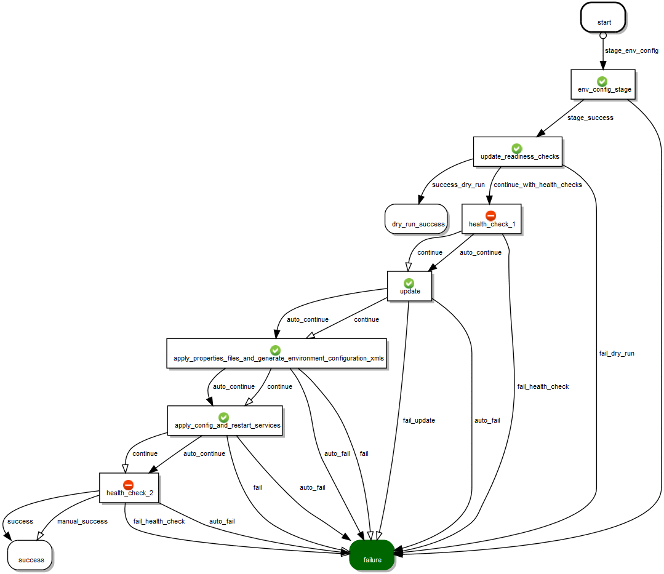
Notes:
This is the same workflow as the previous slide but I want to showcase how it’s flexible enough to deal with different conditions. Even though a failure is seen early on in the deployment, Commander know that it’s not a show stopper. The deployment can continue. It’s not until the second health check that it sees a problem that it knows should trigger a failure.

Slide 19
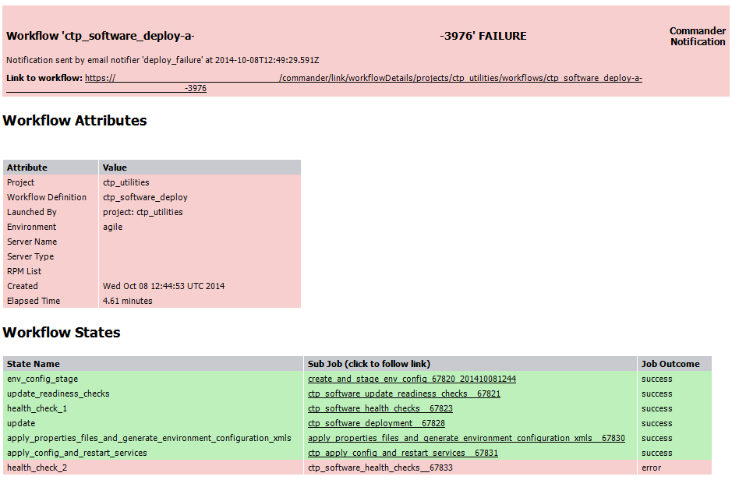
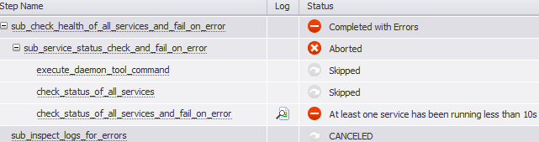
Email Notification– Failed Deployment
Notes:
This is what our email notification look like. Some sensitive data has been scrubbed which is why you say a lot of blanks. The notifiers are sent to predefined email list based on the application. It provides all the information needed know what was being executed. It also provides plenty of links that a user can click on to see more information about the deployment. The link a the top brings you to the workflow page. Clicking on the individual links in the Workflow state area brings you to that state where you can see what was executed and the outcome. Here it can clearly be seen that the reason why the deployment failed is because the application did not start properly after the software deployment

Slide 20
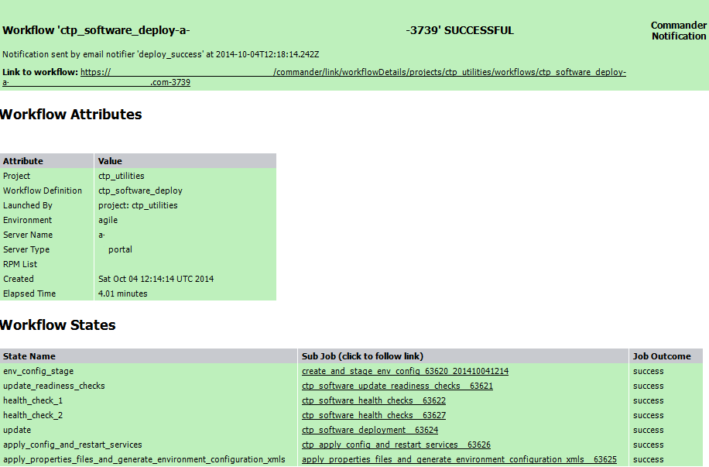
Email Notification– Successful Deployment
Notes:
This is an example of a successful deployment. You can see the difference in color from the previous slide and how we use it as an visual aid to let engineers quickly know that a deployment was successful. These email notifiers have been extremely useful for us. On production deployment night engineers no longer need to wait for feedback from the AppDeploy team to know if something was successful or not. They are notified immediately and with the help of the links can quickly determine where in the process the failure occurred. The response time that we see is great.

Slide 21
Tips and Suggestions

Slide 22
Think Big
Think big, plan big, but start small
Know what your overall goal is but start with a small subset
Standards
Set standards and be consistent
Enforce the same standards across all of your environment
Rebuilt where needed; align environments
Stakeholder Agreement
Organizations goals must align with one another
Every team affected must be aware and be on board with the changes that are to come
Analyze and Reevaluate
You won’t get it 100% correct the first time
Don’t be afraid to change the direction, just make sure you’re prepared
Builds a solid foundation; become really good with that small subset and only then expand
Notes:
Here are my tips and suggestions based on the things I learned along the way. Hopefully there are key take away points to help you so that you don’t have to learned them the hard way.
Think big, plan big, but start small. Know what your overall goal but start with a small subset. You don’t want to bite off more than you can chew. Build a solid foundation, become really good at what you do and then expand. A poorly executed solution is a bad investment for the future.
Set standards, be consistent and enforce them in all your environments. If needed rebuild and align your environments. You will not be successful at automating inconsistency.
Make sure that you have a stake holder agreement and that everyone’s goals are aligned. Every team affected must be aware and be on board with the changes. Not having a team on board could be enough to derail the whole effort.
Don’t forget to stop to analyze and reevaluate your solution. You will not get it 100% correct the first time but you’ll have plenty of opportunity to correct it. You may find that you need to take a new direction. Don’t be afraid of it, just be prepared.
Another item not on this list in changing mindset. The DevOps movement is also about changing mindsets and looking at problems from a different perspective. For many different reason you may find it very difficult to change that mind set of people in the organization. The groups that you’re dealing with may be too large and getting everyone to pay attention isn’t possible. Other business objectives may get in the way. If that happens make sure that you use your tools to set up a process that can’t be bypassed. Engineers are very creative people… that’s good when they are creative with what they are developing, but a problematic when a couple hundred engineers are coming up with different ways to deploy and configure their software. If there’s a tool that can easily be used to deploy and configure software, Engineers will be happy to use it rather than having to come up with something themselves.

Slide 23
Q&A

Slide 25
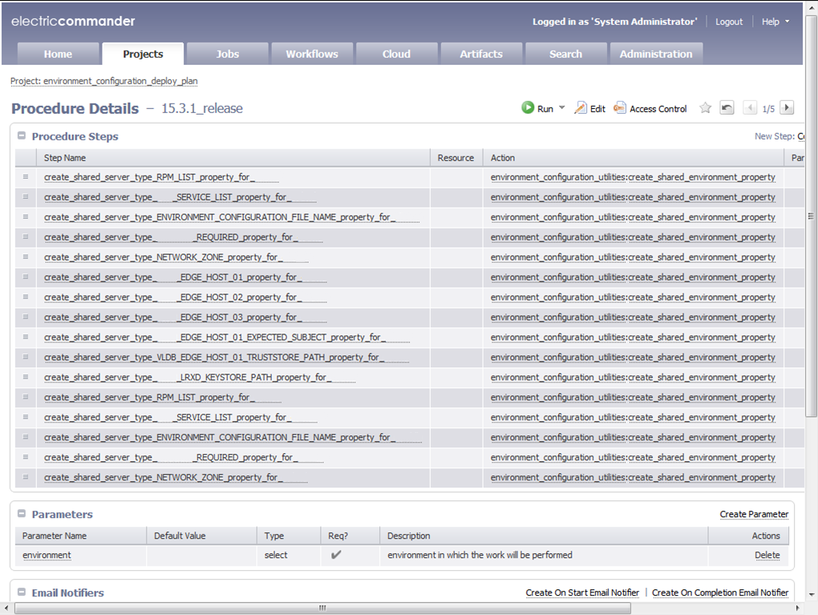
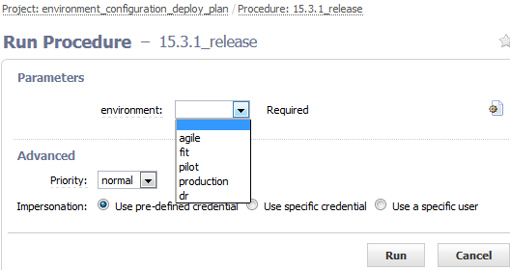

Slide 26
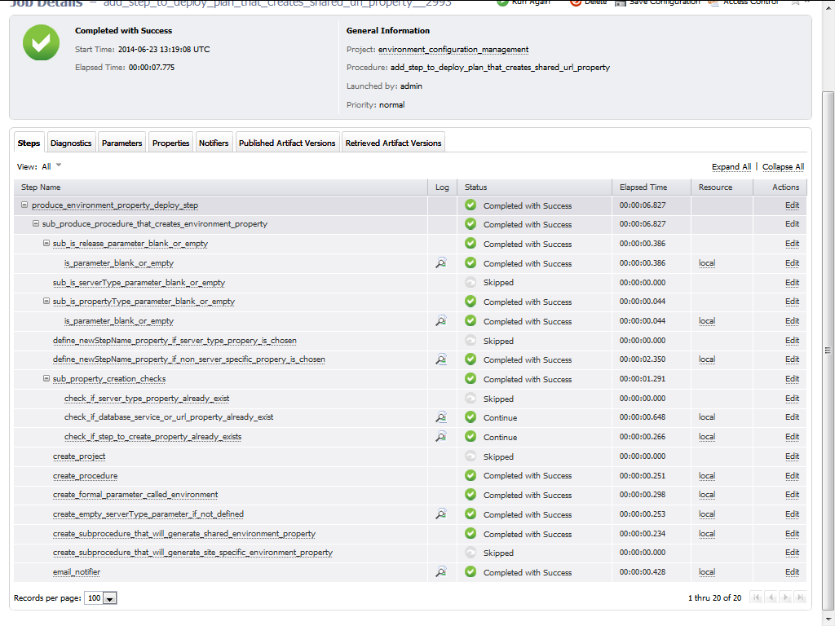

Slide 27
